Slide 1
信息隐藏与数字水印课程汇报
水印去除的图像视频修复
Qi Tang
2023/6/6

Slide 2
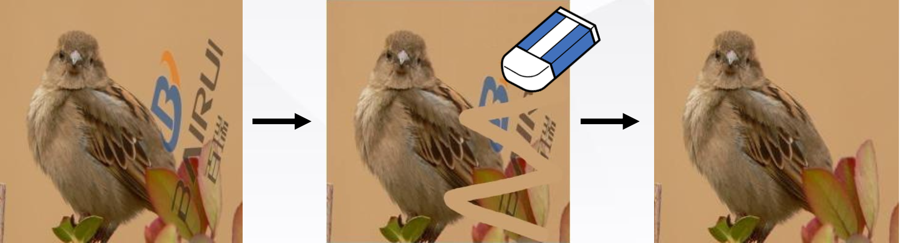
Visible Watermark Removal
What is Watermark Removal?
Watermarked Image
Erasing
Erasing
Huang C H, Wu J L. Attacking visible watermarking schemes[J]. IEEE transactions on multimedia, 2004, 6(1): 16-30.

Slide 3
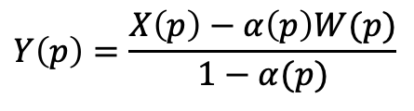
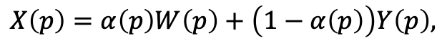
Visible Watermark Removal
What is Watermark Removal?
In the watermarked areas, the relationship between watermarked pixels $X(p)$ and watermark-free pixels $Y(p)$ is formulated as:
$$X\left(p\right)=α\left(p\right)W\left(p\right)+\left(1−α\left(p\right)\right)Y\left(p\right),$$
Where $p=(i, j$) represents the pixel location in the image, $α\left(p\right)$ is a spatially varying opacity, namely the alpha matte used in image processing.
To get a watermark-free image $Y$ from its watermarked image counterpart$X$. Considering Eq. 1, given $W$and$α$, we could trivially invert the process of synthesizing watermarked image via the per-pixel operation:
$$Y\left(p\right)=\frac{X\left(p\right)−α\left(p\right)W(p)}{1−α(p)}$$
Note the non-watermarked areas are kept the same in X and Y .
Huang C H, Wu J L. Attacking visible watermarking schemes[J]. IEEE transactions on multimedia, 2004, 6(1): 16-30.
Notes:
The most commonly used watermarks are translucent to keep the underlying image content partially visible, which means that $\alpha(p)$ is in the interval of $[0,1]$ for all pixels. According to Eq. 1 , if $\alpha(p)=1$ everywhere, $X$ is reduced to $W$; otherwise if $\alpha(p)=0$ everywhere, $X$ is equal to $Y$.

Slide 4
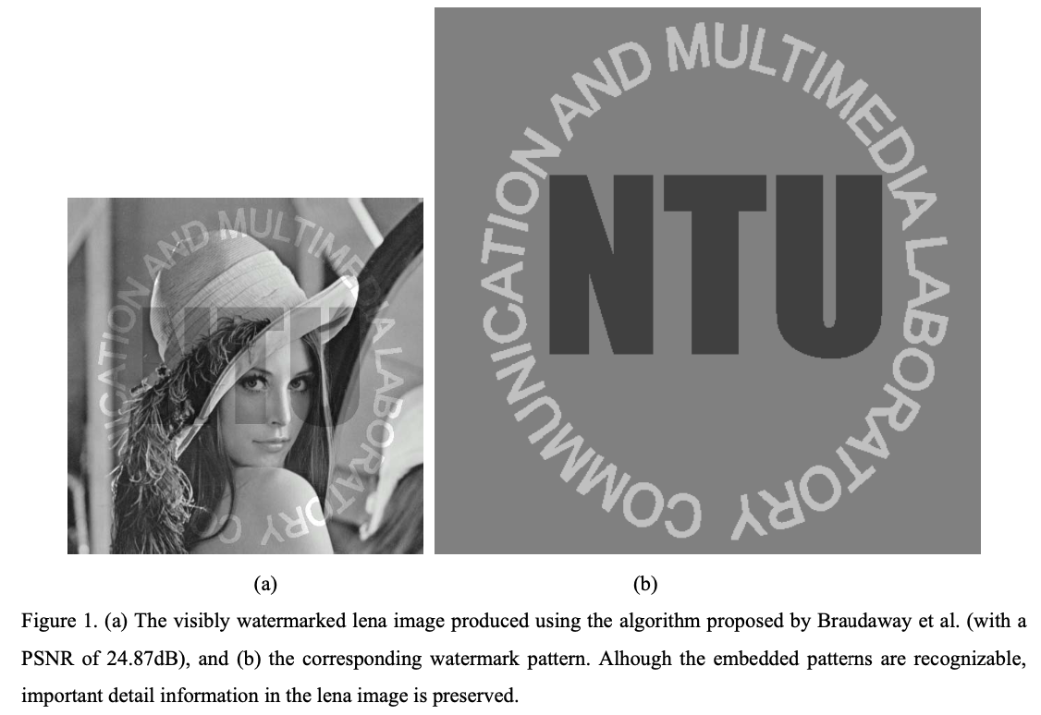
Attacking Visible Watermarking Schemes
Important Obversions
Huang C H, Wu J L. Attacking visible watermarking schemes[J]. IEEE transactions on multimedia, 2004, 6(1): 16-30.
Notes:
由于嵌入的可见水印应该是不引人注目的和保持原始细节的，水印图案不应该包含复杂的纹理或形状结构
嵌入内容中图像细节的可感知性依赖于水印区域中包含的边缘信息的保存。
用户能够识别包含在水印内容中的版权图案的原因主要依赖于嵌入图案的形状(轮廓)被保留并且能够与宿主内容区分开的事实。
可见水印方案的鲁棒性主要在于，如果必须去除水印，则不可避免地要耗费大量人力物力。因此，一个有效的攻击方案应该包括尽可能少的用户干预。但是在攻击过程中，仍然需要某种用户干预——手动选择水印区域。这是因为目前没有自动识别机制能够在没有关于水印模式和嵌入参数的特定领域知识的情况下正确地找出水印嵌入区域。
为了设计一种通用的攻击机制，只有水印内容中的信息才是有用的。也就是说，在标记图像中，只有未标记区域中的像素和带水印区域中的剩余信息可以在水印去除期间被利用。其他信息，例如嵌入参数或水印图像的实际强度，被认为是未知的，因为攻击者只能得到嵌入的内容。

Slide 5
Attacking Visible Watermarking Schemes
Important Obversions
Since embedded visible watermark should be unobtrusive and original-detail-preserving, watermark patterns should not contain complex textures or shape structures.
The perceptibility of image details in the embedded content relies on the preservation of edge information contained within the watermarked area.
The reason why users can identify copyright patterns contained in watermarked contents mainly relies on the fact that the shapes (contours) of embedded patterns are preserved and could be differentiated from host contents.
The robustness of visible watermarking schemes mainly lies on the inevitability of applying exhaustive and costly labors, if its removal is a must.
To devise a general attacking mechanism, only information in the watermarked contents can be of use.
Huang C H, Wu J L. Attacking visible watermarking schemes[J]. IEEE transactions on multimedia, 2004, 6(1): 16-30.
Notes:
由于嵌入的可见水印应该是不引人注目的和保持原始细节的，水印图案不应该包含复杂的纹理或形状结构
嵌入内容中图像细节的可感知性依赖于水印区域中包含的边缘信息的保存。
用户能够识别包含在水印内容中的版权图案的原因主要依赖于嵌入图案的形状(轮廓)被保留并且能够与宿主内容区分开的事实。
可见水印方案的鲁棒性主要在于，如果必须去除水印，则不可避免地要耗费大量人力物力。因此，一个有效的攻击方案应该包括尽可能少的用户干预。但是在攻击过程中，仍然需要某种用户干预——手动选择水印区域。这是因为目前没有自动识别机制能够在没有关于水印模式和嵌入参数的特定领域知识的情况下正确地找出水印嵌入区域。
为了设计一种通用的攻击机制，只有水印内容中的信息才是有用的。也就是说，在标记图像中，只有未标记区域中的像素和带水印区域中的剩余信息可以在水印去除期间被利用。其他信息，例如嵌入参数或水印图像的实际强度，被认为是未知的，因为攻击者只能得到嵌入的内容。

Slide 6
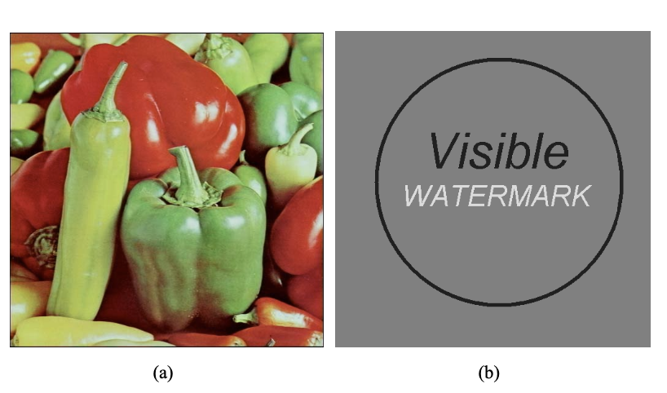
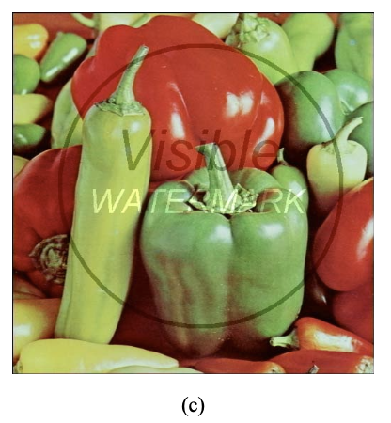
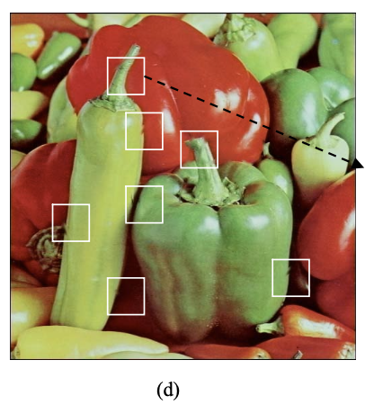
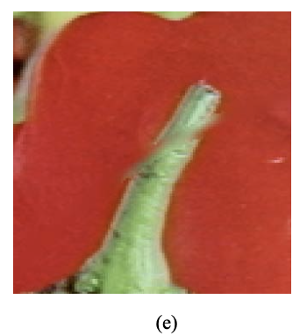
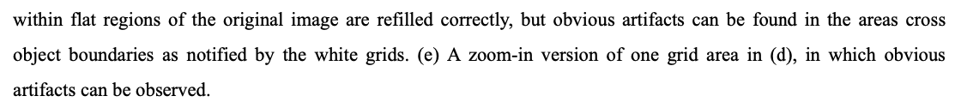
Attacking Visible Watermarking Schemes
Attacking Simple Watermarks with Image Recovery Techniques
Huang C H, Wu J L. Attacking visible watermarking schemes[J]. IEEE transactions on multimedia, 2004, 6(1): 16-30.

Slide 7
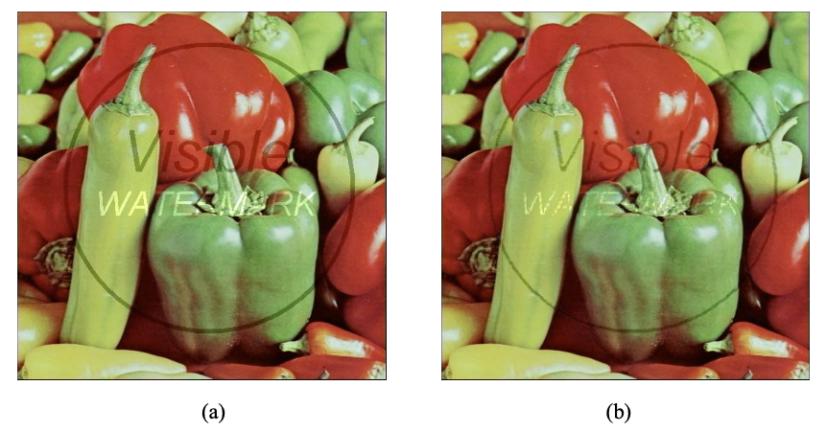
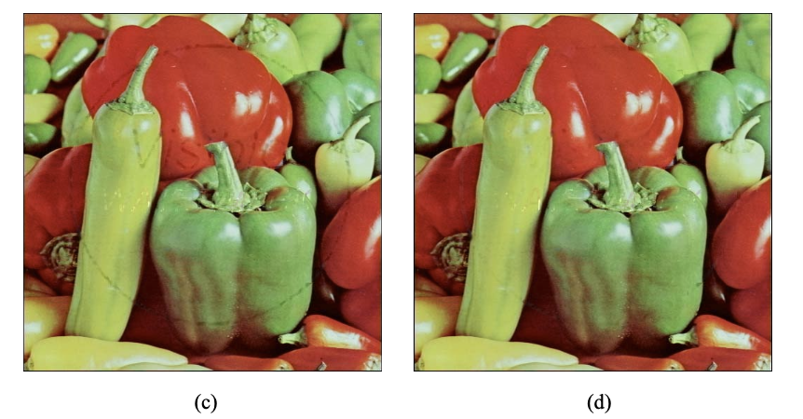
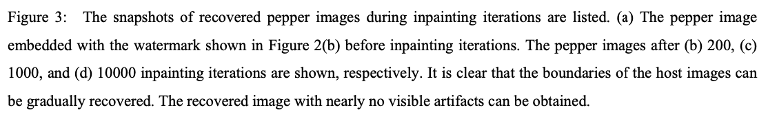
Attacking Visible Watermarking Schemes
Attacking Simple Watermarks with Image Recovery Techniques
Huang C H, Wu J L. Attacking visible watermarking schemes[J]. IEEE transactions on multimedia, 2004, 6(1): 16-30.

Slide 8
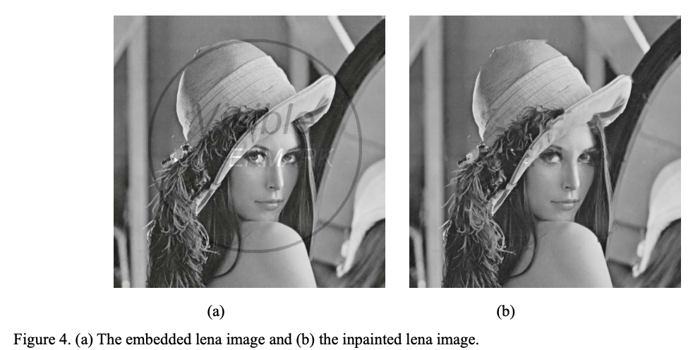
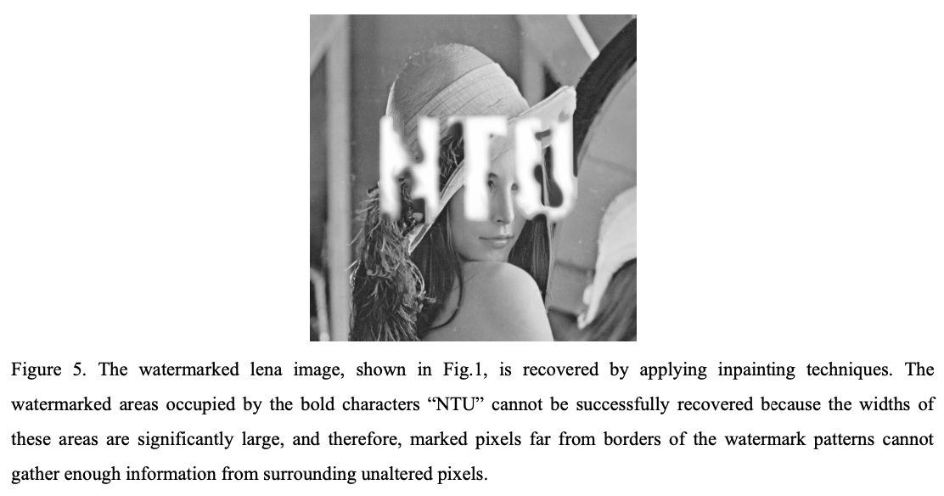
Attacking Visible Watermarking Schemes
Attacking General Watermarks with the Proposed Algorithms
Huang C H, Wu J L. Attacking visible watermarking schemes[J]. IEEE transactions on multimedia, 2004, 6(1): 16-30.

Slide 9
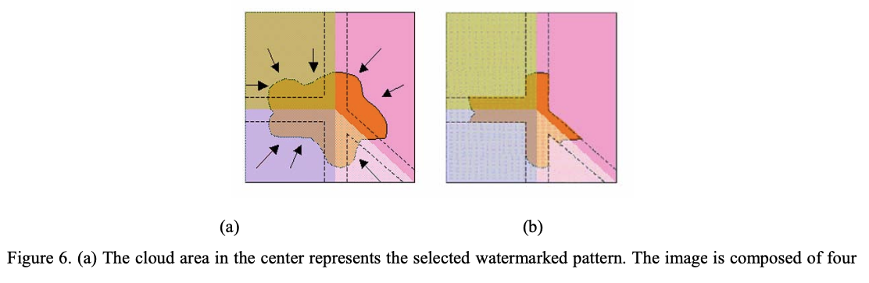
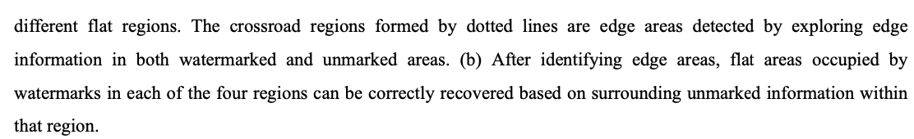
Attacking Visible Watermarking Schemes
Attacking General Watermarks with the Proposed Algorithms
Huang C H, Wu J L. Attacking visible watermarking schemes[J]. IEEE transactions on multimedia, 2004, 6(1): 16-30.

Slide 10
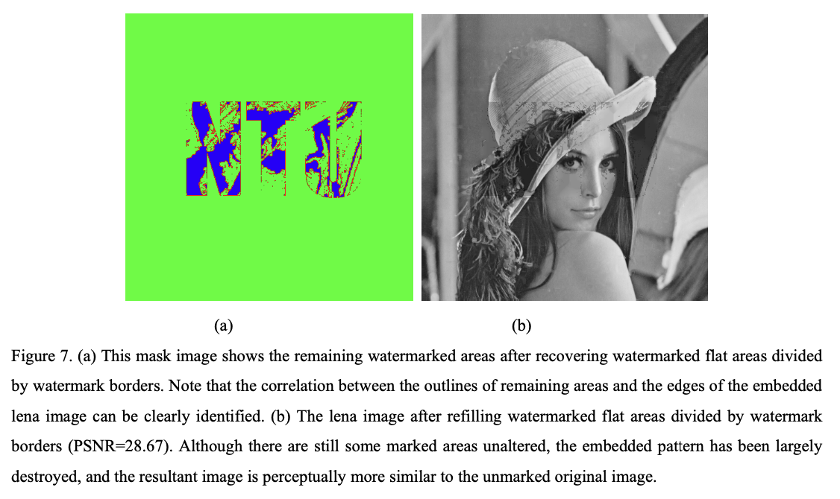
Attacking Visible Watermarking Schemes
Attacking General Watermarks with the Proposed Algorithms
Huang C H, Wu J L. Attacking visible watermarking schemes[J]. IEEE transactions on multimedia, 2004, 6(1): 16-30.

Slide 11
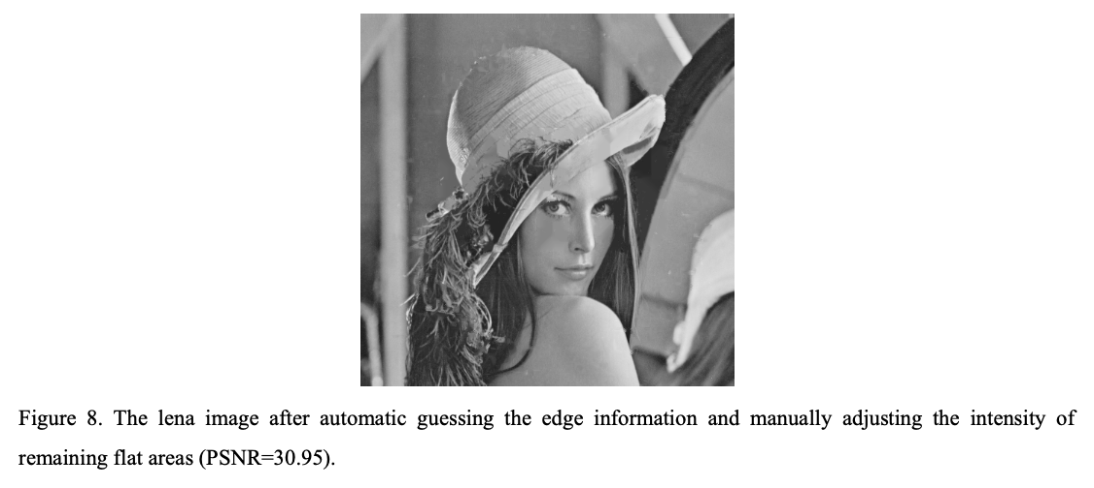
Attacking Visible Watermarking Schemes
Attacking General Watermarks with the Proposed Algorithms
Huang C H, Wu J L. Attacking visible watermarking schemes[J]. IEEE transactions on multimedia, 2004, 6(1): 16-30.

Slide 12
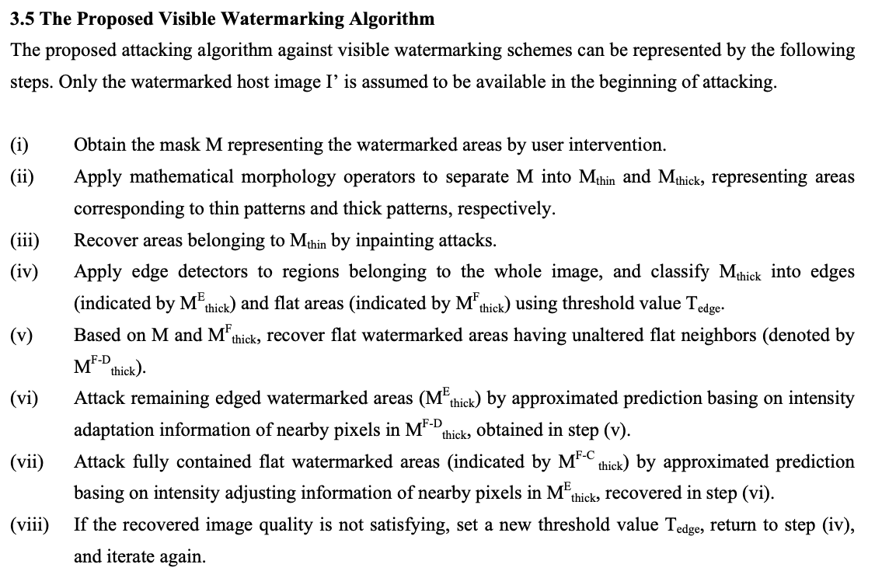
Attacking Visible Watermarking Schemes
Attacking Simple Watermarks with Image Recovery Techniques
Huang C H, Wu J L. Attacking visible watermarking schemes[J]. IEEE transactions on multimedia, 2004, 6(1): 16-30.

Slide 13
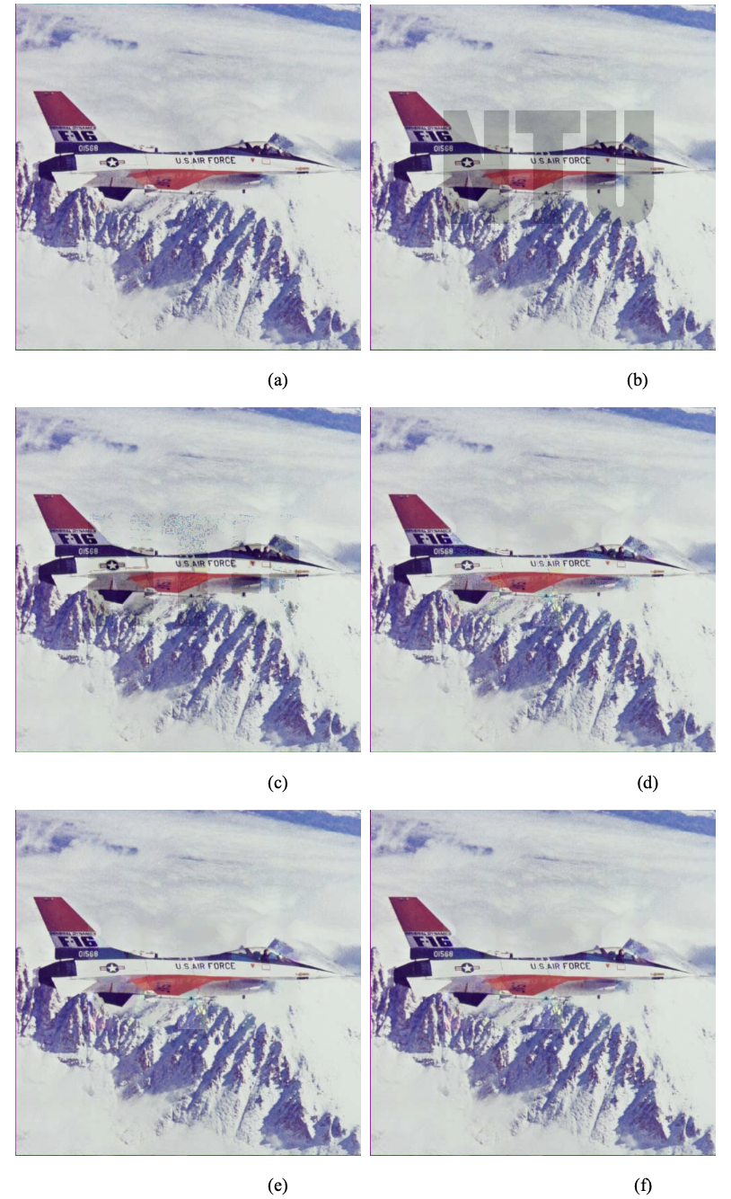
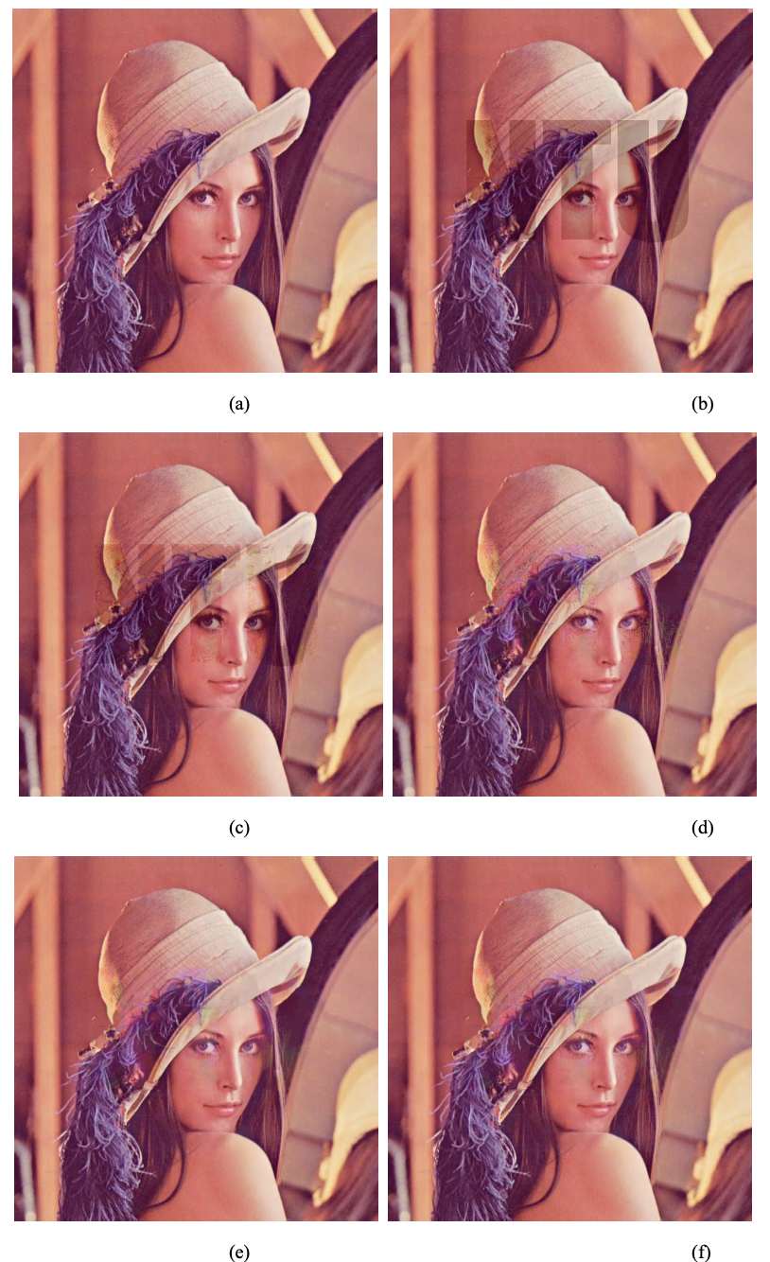
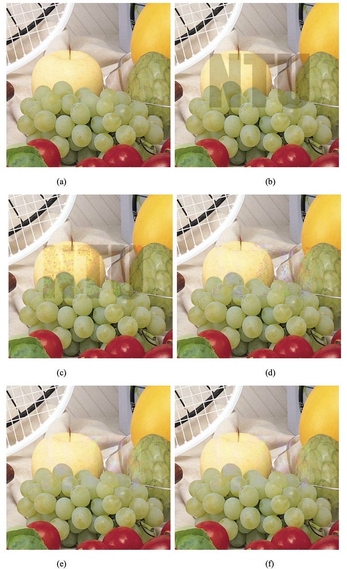
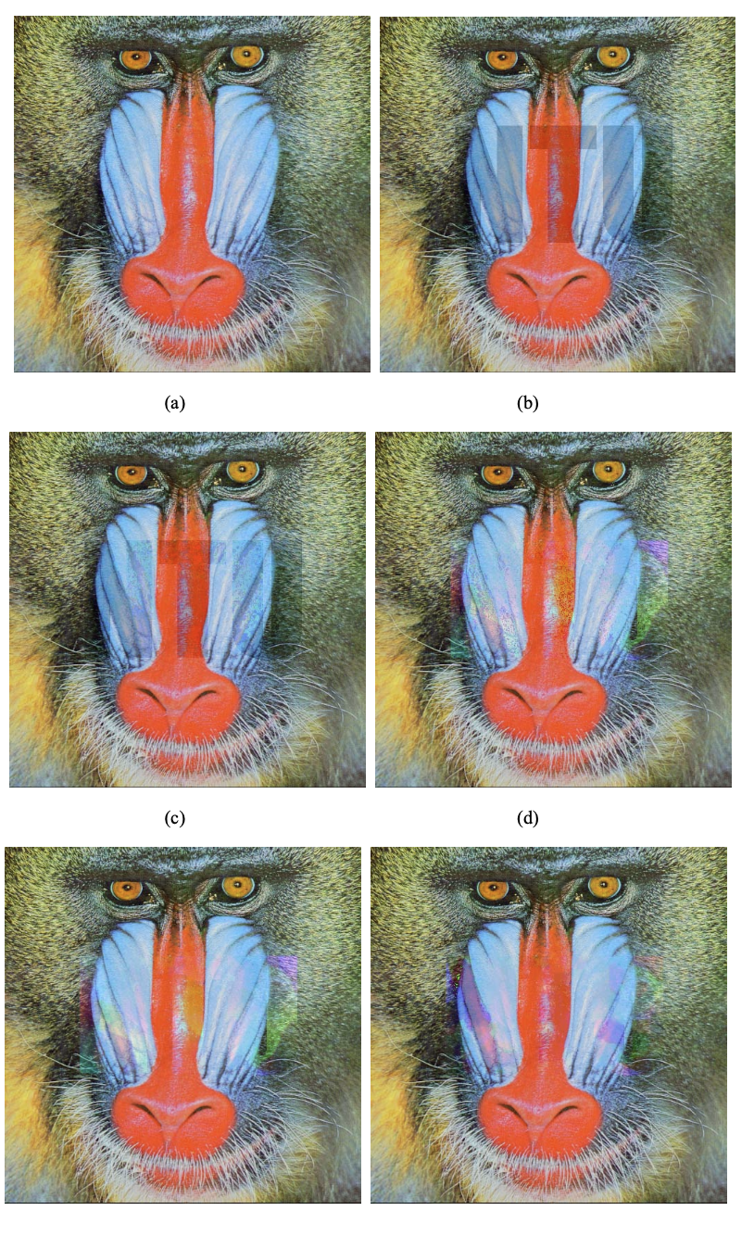
Attacking Visible Watermarking Schemes
Attacking Simple Watermarks with Image Recovery Techniques
Huang C H, Wu J L. Attacking visible watermarking schemes[J]. IEEE transactions on multimedia, 2004, 6(1): 16-30.

Slide 14
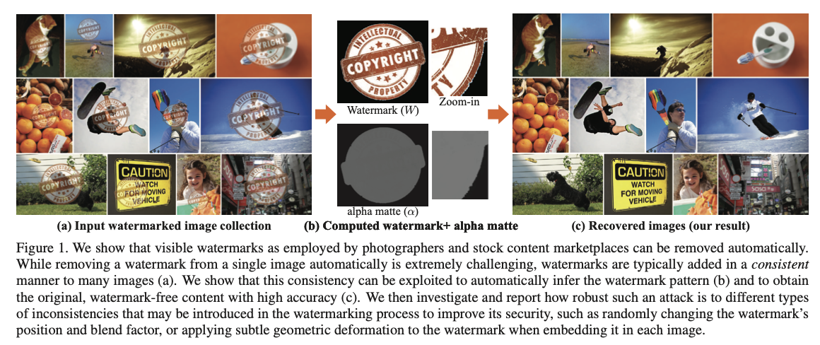
On the Effectiveness of Visible Watermarks
An Attack on Watermarked Collections
Watermarks are typically added in a consistent way to many images.
Dekel T, Rubinstein M, Liu C, et al. On the effectiveness of visible watermarks[C]//Proceedings of the IEEE Conference on Computer Vision and Pattern Recognition. 2017: 2146-2154.

Slide 15
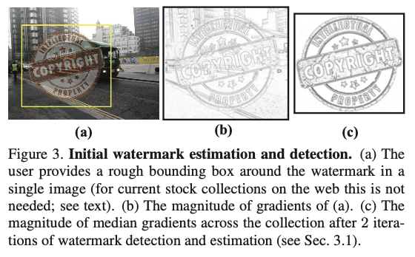
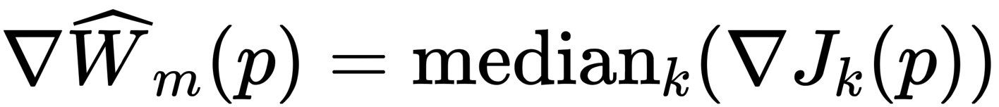
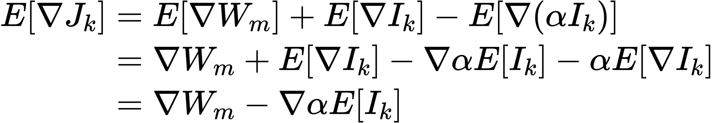
On the Effectiveness of Visible Watermarks
Initial Watermark Estimation & Detection
I. Estimating the Matted Watermark
II. Watermark Detection
detect the watermark in each of the images using Chamfer Distance commonly used for template matching in object detection and recognition
Dekel T, Rubinstein M, Liu C, et al. On the effectiveness of visible watermarks[C]//Proceedings of the IEEE Conference on Computer Vision and Pattern Recognition. 2017: 2146-2154.
Notes:
The first task is to determine which image structures in the collection belong to the common watermark, and to detect them in all the images. This is a chicken and an egg problem since estimating the watermark requires knowing which regions in the images are watermarked, and vice versa. We solve this by jointly estimating the matted water- mark and detecting it in all the images. Specifically, we iterate between the following estimation and detection steps.
第一个任务是确定集合中哪些图像结构属于公共水印，并在所有图像中检测它们。这是一个先有鸡还是先有蛋的问题，因为估计水印需要知道图像中的哪些区域被加了水印，反之亦然。我们通过联合估计乱糟糟的水印并在所有图像中检测它来解决这个问题。具体来说，我们在以下估计和检测步骤之间进行。

Slide 16
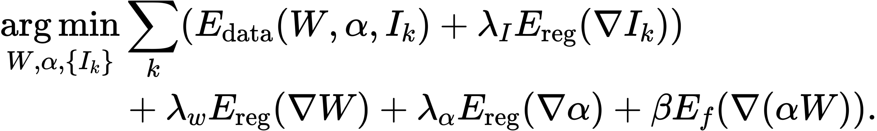
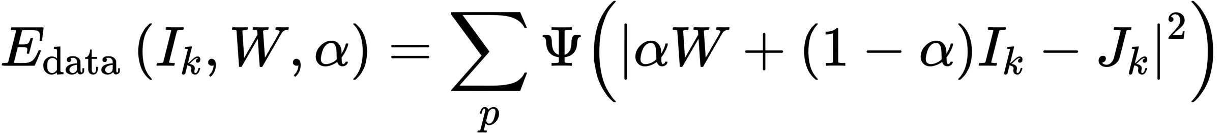
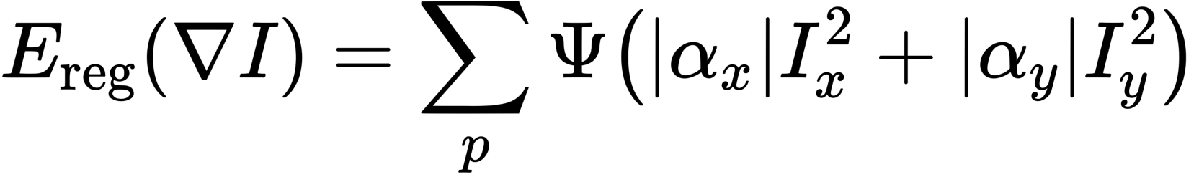
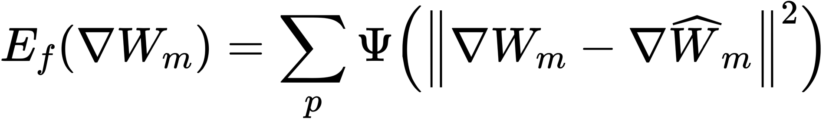
On the Effectiveness of Visible Watermarks
Multi-Image Matting and Reconstruction
our goal is then to solve the multi image matting problem, i.e., decompose the observed intensities in each image into their watermark, alpha-matte, and original image components.
Once we have the solution for W and α, we can use them to remove the watermark from any new image marked by it, without the need to run the entire pipeline again.
Dekel T, Rubinstein M, Liu C, et al. On the effectiveness of visible watermarks[C]//Proceedings of the IEEE Conference on Computer Vision and Pattern Recognition. 2017: 2146-2154.

Slide 17
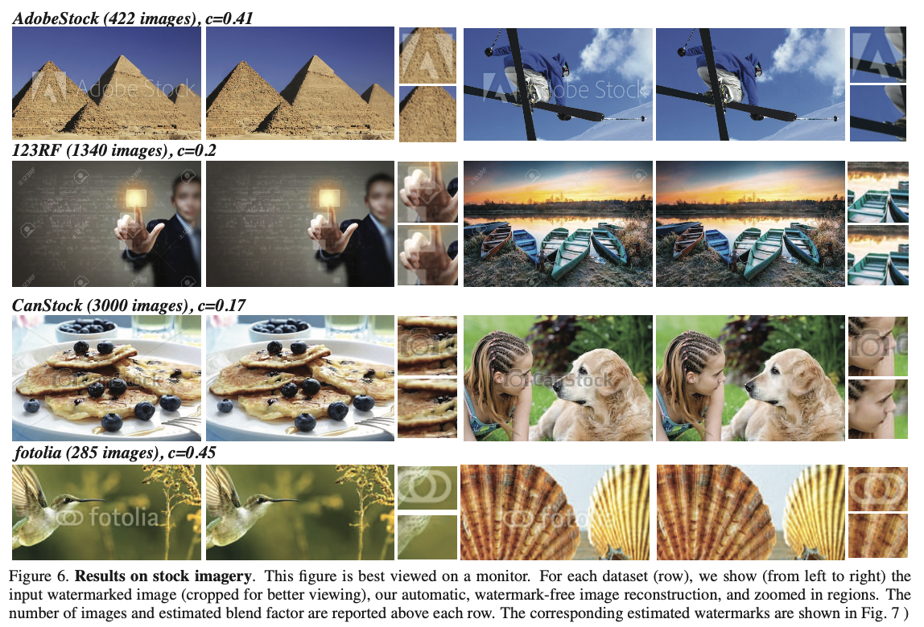
On the Effectiveness of Visible Watermarks
Multi-Image Matting and Reconstruction
Dekel T, Rubinstein M, Liu C, et al. On the effectiveness of visible watermarks[C]//Proceedings of the IEEE Conference on Computer Vision and Pattern Recognition. 2017: 2146-2154.

Slide 18
On the Effectiveness of Visible Watermarks
A Generalized Watermarking Model
We study how robust the attack is to various types of inconsistencies—or variations—that could potentially be introduced while embedding the watermark in each image. We show,
randomly changing the position of the watermark across the collection does not prevent such an attack from detecting and removing the watermark,
nor do random changes in the watermark’s opacity or color.
Interestingly, we found that applying small spatial deformation to the watermarks during embedding can significantly degrade the quality of the watermark-removed images, with only imperceptible changes to the watermark itself.
Dekel T, Rubinstein M, Liu C, et al. On the effectiveness of visible watermarks[C]//Proceedings of the IEEE Conference on Computer Vision and Pattern Recognition. 2017: 2146-2154.
Notes:
As such an attack relies on the watermark’s consistency across the image collection, a natural question is whether one could prevent it by breaking this consistency.

Slide 19
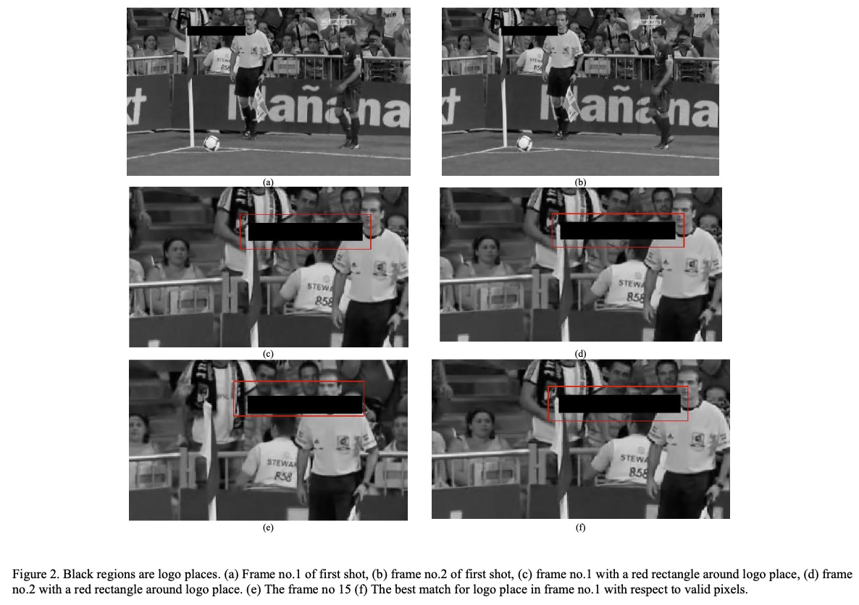
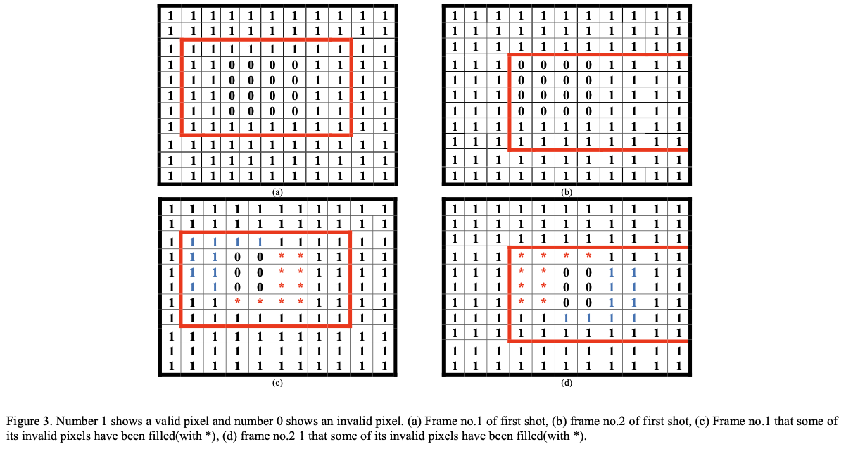
Video Logo Removal Using Iterative Subsequent Matching
Video Shots and Subsequent Matching
Dashti M, Safabakhsh R, Pourfard M, et al. Video logo removal using iterative subsequent matching[C]//2015 The International Symposium on Artificial Intelligence and Signal Processing (AISP). IEEE, 2015: 84-88.
Notes:
As such an attack relies on the watermark’s consistency across the image collection, a natural question is whether one could prevent it by breaking this consistency.

Slide 20
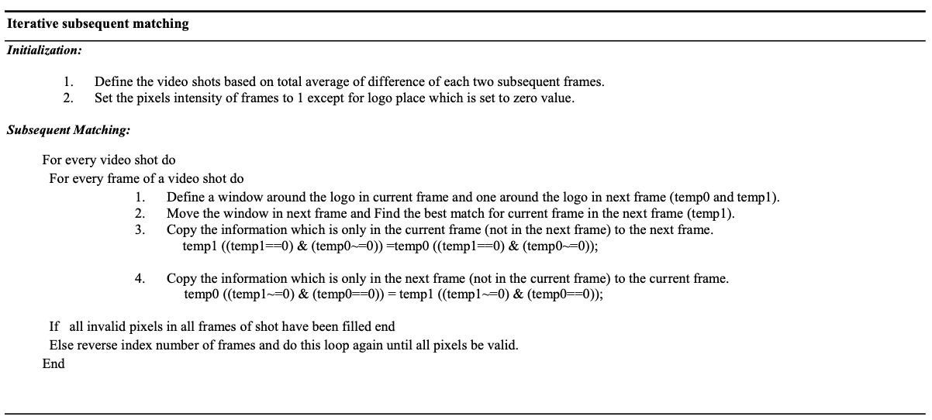
Video Logo Removal Using Iterative Subsequent Matching
The Algorithm of Iterative Subsequent Matching
Dashti M, Safabakhsh R, Pourfard M, et al. Video logo removal using iterative subsequent matching[C]//2015 The International Symposium on Artificial Intelligence and Signal Processing (AISP). IEEE, 2015: 84-88.
Notes:
As such an attack relies on the watermark’s consistency across the image collection, a natural question is whether one could prevent it by breaking this consistency.

Slide 21
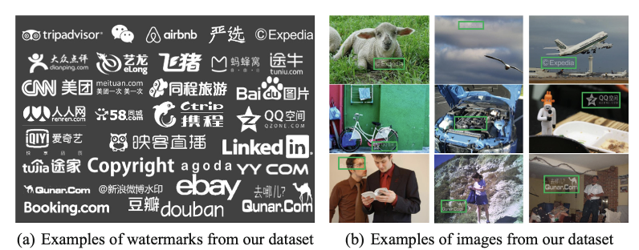
Large-Scale Visible Watermark Detection and Removal with Deep Convolutional Networks
The Diversity of Large-Scale Watermark Dataset
containing 60000 watermarked images made of 80 watermarks, with 750 images per watermark.
Cheng D, Li X, Li W H, et al. Large-scale visible watermark detection and removal with deep convolutional networks[C]//Pattern Recognition and Computer Vision: First Chinese Conference, PRCV 2018, Guangzhou, China, November 23-26, 2018, Proceedings, Part III 1. Springer International Publishing, 2018: 27-40.
Notes:
As such an attack relies on the watermark’s consistency across the image collection, a natural question is whether one could prevent it by breaking this consistency.

Slide 22
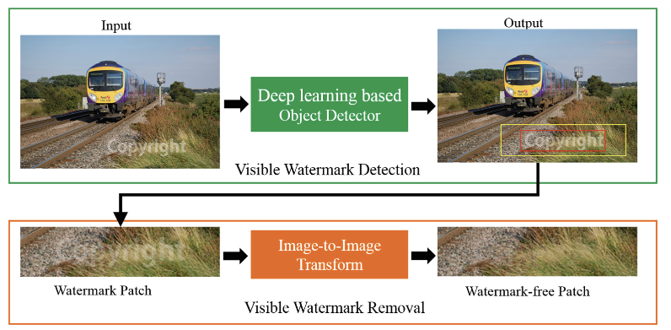
Large-Scale Visible Watermark Detection and Removal with Deep Convolutional Networks
Visible Watermark Detection and Removal
Cheng D, Li X, Li W H, et al. Large-scale visible watermark detection and removal with deep convolutional networks[C]//Pattern Recognition and Computer Vision: First Chinese Conference, PRCV 2018, Guangzhou, China, November 23-26, 2018, Proceedings, Part III 1. Springer International Publishing, 2018: 27-40.
Notes:
In the period of detection, the goal is to judge whether a image has watermark and locate the water- marked area (the red box). Then, we enlarge the detection boundingbox (the yellow box) and crop the watermarked patch to generate the input for watermark removal. (Color figure online)

Slide 23
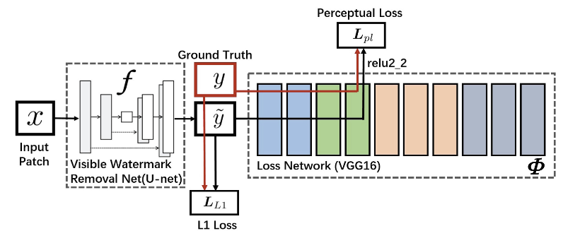
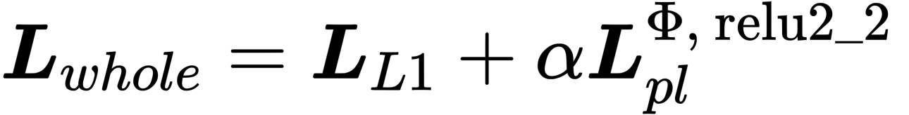
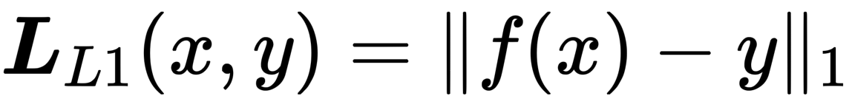
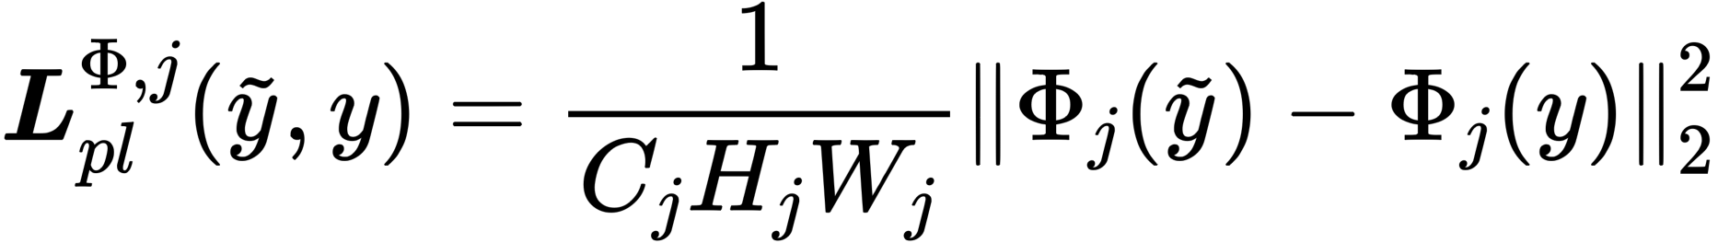
Large-Scale Visible Watermark Detection and Removal with Deep Convolutional Networks
Visible Watermark Detection and Removal
Cheng D, Li X, Li W H, et al. Large-scale visible watermark detection and removal with deep convolutional networks[C]//Pattern Recognition and Computer Vision: First Chinese Conference, PRCV 2018, Guangzhou, China, November 23-26, 2018, Proceedings, Part III 1. Springer International Publishing, 2018: 27-40.
Notes:
In the period of detection, the goal is to judge whether a image has watermark and locate the water- marked area (the red box). Then, we enlarge the detection boundingbox (the yellow box) and crop the watermarked patch to generate the input for watermark removal. (Color figure online)

Slide 24
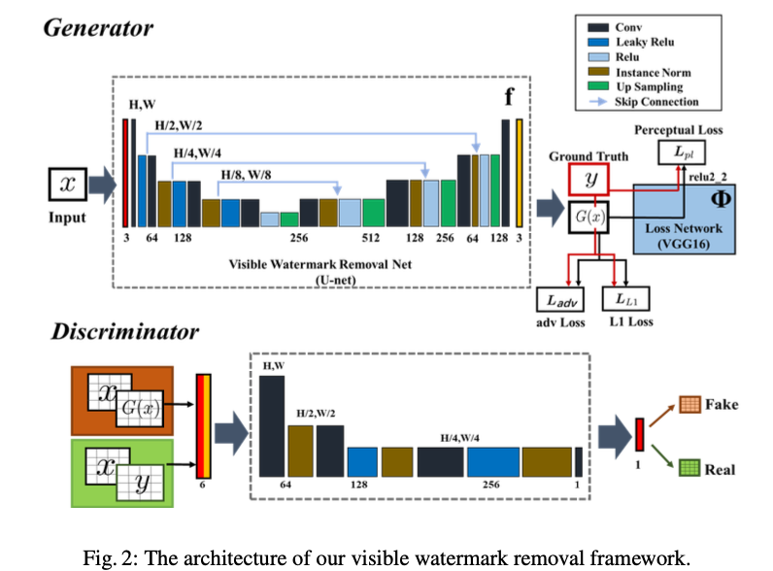
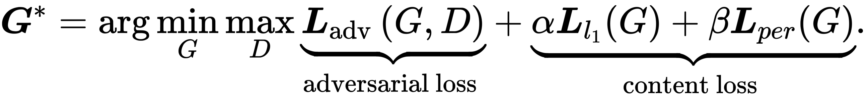
Towards Photo-Realistic Visible Watermark Removal with Conditional Generative Adversarial Networks
Conditional Generative Adversarial Networks
Li X, Lu C, Cheng D, et al. Towards photo-realistic visible watermark removal with conditional generative adversarial networks[C]//Image and Graphics: 10th International Conference, ICIG 2019, Beijing, China, August 23–25, 2019, Proceedings, Part I 10. Springer International Publishing, 2019: 345-356.
Notes:
However, directly training a generator with pixel-wise loss to estimate pixel relation mapping is difficult. In addi- tion, the watermark-free images recovered by this kind of approach mostly contains a few residual watermark traces and are perceptually not photo-realistic in human visual sense (Fig. 1(b)).

Slide 25
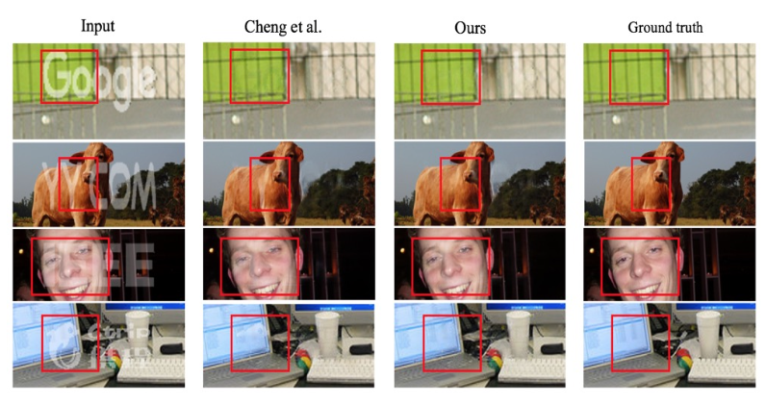
Towards Photo-Realistic Visible Watermark Removal with Conditional Generative Adversarial Networks
Conditional Generative Adversarial Networks
Li X, Lu C, Cheng D, et al. Towards photo-realistic visible watermark removal with conditional generative adversarial networks[C]//Image and Graphics: 10th International Conference, ICIG 2019, Beijing, China, August 23–25, 2019, Proceedings, Part I 10. Springer International Publishing, 2019: 345-356.
Notes:
However, directly training a generator with pixel-wise loss to estimate pixel relation mapping is difficult. In addi- tion, the watermark-free images recovered by this kind of approach mostly contains a few residual watermark traces and are perceptually not photo-realistic in human visual sense (Fig. 1(b)).

Slide 26
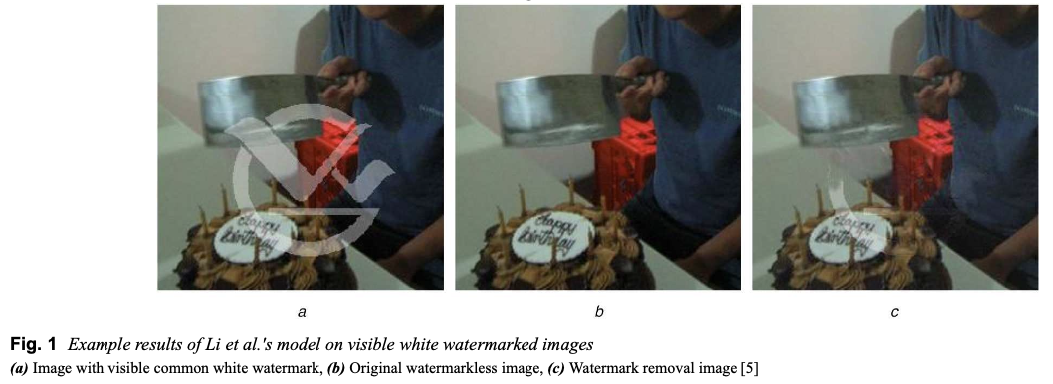
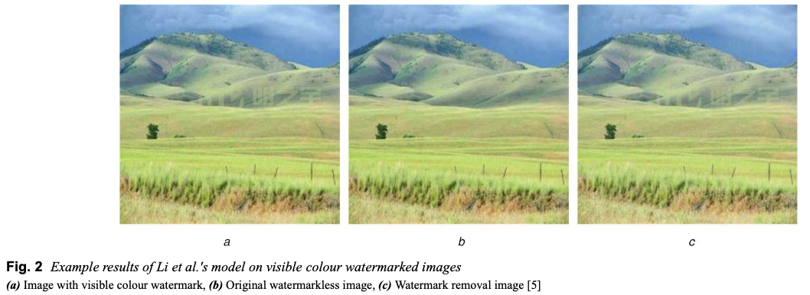
Two-stage visible watermark removal architecture based on deep learning
Observations
Jiang P, He S, Yu H, et al. Two‐stage visible watermark removal architecture based on deep learning[J]. IET Image Processing, 2020, 14(15): 3819-3828.
Notes:
However, for a white watermarked image, as show in Fig. 1, there are still residual watermark after removing watermark. Furthermore, the method proposed by Li and colleagues has no ability to remove the visible watermark whose colour is very similar to the background colour, as shown in Fig. 2.

Slide 27

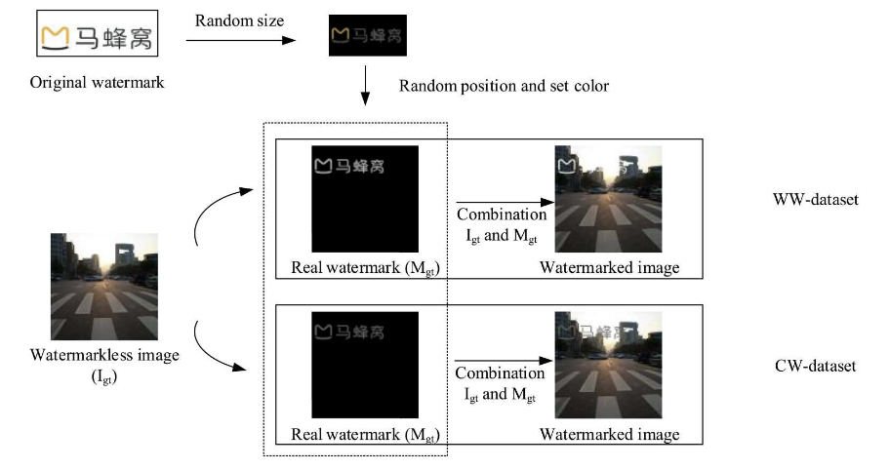
Two-stage visible watermark removal architecture based on deep learning
WW-data set and CW-data set
Jiang P, He S, Yu H, et al. Two‐stage visible watermark removal architecture based on deep learning[J]. IET Image Processing, 2020, 14(15): 3819-3828.

Slide 28
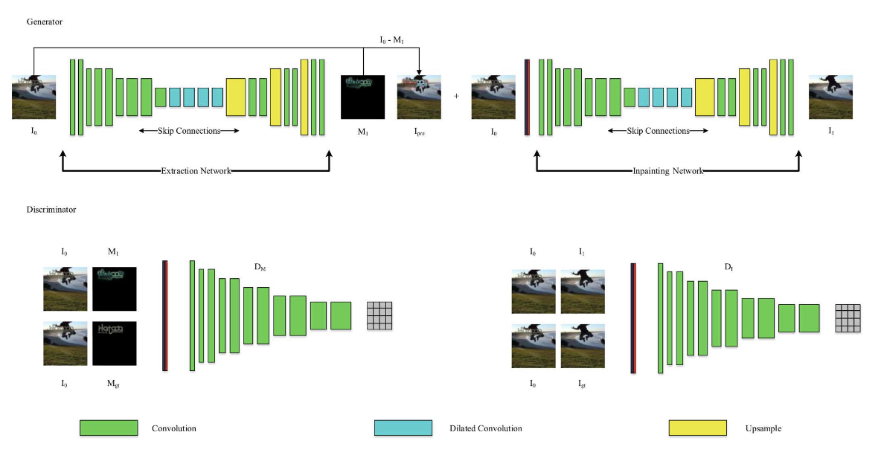
Two-stage visible watermark removal architecture based on deep learning
CGANs and LSGANs
Jiang P, He S, Yu H, et al. Two‐stage visible watermark removal architecture based on deep learning[J]. IET Image Processing, 2020, 14(15): 3819-3828.
Notes:
This architecture includes two main components, i.e. watermark extraction and image inpainting. Specifically, first, the watermark in a watermarked image is extracted through the extraction network, which mainly focuses on the watermark areas of the watermarked image. Then, a preliminary watermark removal image is obtained by subtracting the extracted watermark from the watermarked image. Finally, the preliminary watermark removal mage is input into the inpainting network to obtain a more consistent and authentic watermark removal image. To the best of the author's knowledge, it is the first deep learning-based watermark removal method combining the methods which focus on watermark region of the watermarked image with the methods of image inpainting to remove watermark in the watermarked image. Compared with the traditional methods, the proposed method does not need to manually select the watermark area, and can also effectively remove the watermark for a single watermarked image. In addition, the end-to-end training of our network architecture can be easily implemented than that of the network architecture developed in [6]. Our proposed method also has stronger capability than the method given in [5] in terms of the watermark removal, which directly inpaints the area covered by the watermark without explicitly learning the features of the watermark.

Slide 29
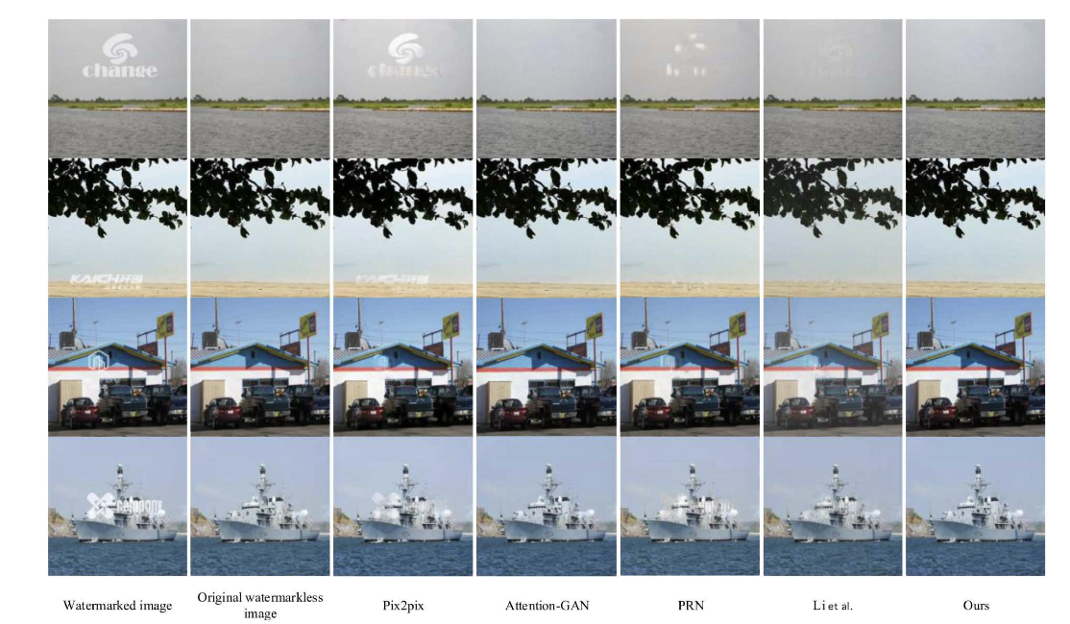
Two-stage visible watermark removal architecture based on deep learning
Comparison of watermark removal results on WW-data sets
Jiang P, He S, Yu H, et al. Two‐stage visible watermark removal architecture based on deep learning[J]. IET Image Processing, 2020, 14(15): 3819-3828.

Slide 30
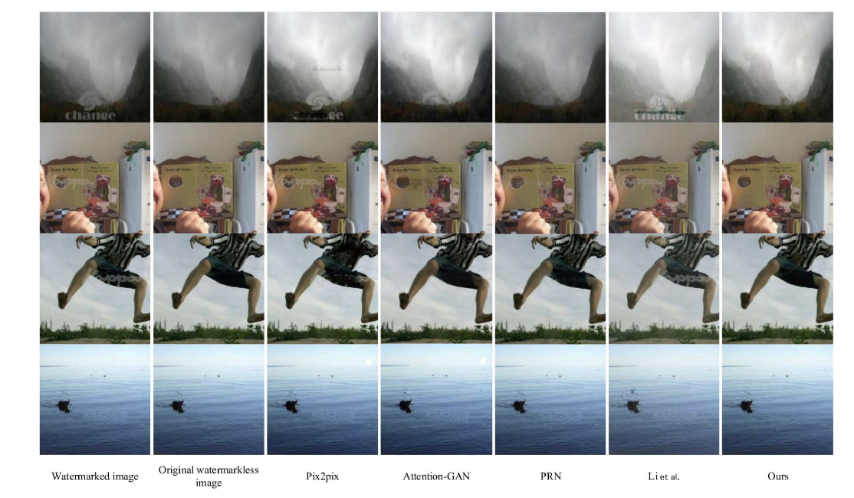
Two-stage visible watermark removal architecture based on deep learning
Comparison of watermark removal results on CW-data sets
Jiang P, He S, Yu H, et al. Two‐stage visible watermark removal architecture based on deep learning[J]. IET Image Processing, 2020, 14(15): 3819-3828.

Slide 31

Blind Visual Motif Removal from a Single Image
Blind Visual Motif Removal
Hertz A, Fogel S, Hanocka R, et al. Blind visual motif removal from a single image[C]//Proceedings of the IEEE/CVF Conference on Computer Vision and Pattern Recognition. 2019: 6858-6867.
Notes:
In the blind setting, the exact location, structure and size of these motifs is unknown. The generalization ability of our network is demonstrated by removing visual motifs that are not seen during training, e.g., watermark re- moval from real-world images. See Figures 1 and 8 for ex- amples of visual motif removal.
Unlike previous approaches, our strategy does not re- quire multiple images with the same object to be removed, or the exact location of the motif pixels. Our technique ex- ploits the ability of deep neural networks to generalize from samples seen during training to unseen samples during test time, thereby enabling the removal of novel (i.e., unseen) motifs. The network learns to separate the visual motif from the image, by first estimating which pixels contain the motif and subsequently reconstructing the latent image. In addi- tion to estimating the binary motif matte and reconstructing the latent image, we also reconstruct the visual motif.

Slide 32

Blind Visual Motif Removal from a Single Image
Blind Visual Motif Removal
Hertz A, Fogel S, Hanocka R, et al. Blind visual motif removal from a single image[C]//Proceedings of the IEEE/CVF Conference on Computer Vision and Pattern Recognition. 2019: 6858-6867.

Slide 33

Blind Visual Motif Removal from a Single Image
Blind Visual Motif Removal
Hertz A, Fogel S, Hanocka R, et al. Blind visual motif removal from a single image[C]//Proceedings of the IEEE/CVF Conference on Computer Vision and Pattern Recognition. 2019: 6858-6867.

Slide 34

Blind Visual Motif Removal from a Single Image
Blind Visual Motif Removal
Hertz A, Fogel S, Hanocka R, et al. Blind visual motif removal from a single image[C]//Proceedings of the IEEE/CVF Conference on Computer Vision and Pattern Recognition. 2019: 6858-6867.

Slide 35


Watermark-Decomposition Network for Visible Watermark Removal
Watermark-Decomposition Network
Liu Y, Zhu Z, Bai X. Wdnet: Watermark-decomposition network for visible watermark removal[C]//Proceedings of the IEEE/CVF Winter Conference on Applications of Computer Vision. 2021: 3685-3693.

Slide 36

Split then Refine: Stacked Attention-guided ResUNets for Blind Single Image Visible Watermark Removal
SplitNet
Cun X, Pun C M. Split then refine: stacked attention-guided ResUNets for blind single image visible watermark removal[C]//Proceedings of the AAAI Conference on Artificial Intelligence. 2021, 35(2): 1184-1192.

Slide 37

Visible Watermark Removal via Self-calibrated Localization and Background Refinement
SLBR
Liang J, Niu L, Guo F, et al. Visible watermark removal via self-calibrated localization and background refinement[C]//Proceedings of the 29th ACM International Conference on Multimedia. 2021: 4426-4434.

Slide 38

Visible Watermark Removal via Self-calibrated Localization and Background Refinement
SLBR
Liang J, Niu L, Guo F, et al. Visible watermark removal via self-calibrated localization and background refinement[C]//Proceedings of the 29th ACM International Conference on Multimedia. 2021: 4426-4434.

Slide 39

Visible Watermark Removal via Self-calibrated Localization and Background Refinement
SLBR
Liang J, Niu L, Guo F, et al. Visible watermark removal via self-calibrated localization and background refinement[C]//Proceedings of the 29th ACM International Conference on Multimedia. 2021: 4426-4434.

Slide 40



Towards An End-to-End Framework for Flow-Guided Video Inpainting
E²FGVI
Li Z, Lu C Z, Qin J, et al. Towards an end-to-end framework for flow-guided video inpainting[C]//Proceedings of the IEEE/CVF Conference on Computer Vision and Pattern Recognition. 2022: 17562-17571.

Slide 41


Deformable Sprites for Unsupervised Video Decomposition
Video Decomposition with Deformable Sprites
Ye V, Li Z, Tucker R, et al. Deformable sprites for unsupervised video decomposition[C]//Proceedings of the IEEE/CVF Conference on Computer Vision and Pattern Recognition. 2022: 2657-2666.

Slide 42


Watermark and Diffusion Model
Removal and Rooting
Instructing to Remove Objects
with Diffusion Models
Latent Diffusion Inpainting
Yildirim A B, Baday V, Erdem E, et al. Inst-Inpaint: Instructing to Remove Objects with Diffusion Models[J]. arXiv preprint arXiv:2304.03246, 2023.

Slide 43



Watermark and Diffusion Model
Removal and Rooting
Fernandez P, Couairon G, Jégou H, et al. The Stable Signature: Rooting Watermarks in Latent Diffusion Models[J]. arXiv preprint arXiv:2303.15435, 2023.

Slide 44
Thank you

